Slide 1
Monkey Banana Problem Using Prolog
Presented by: Sarbajit MuKherjee Zenefa Rahaman
Dept. of Computer Science & Technology, BESUS.

Slide 2
Problem: Monkey and Banana
The Problem Statement :
There is a monkey at the door into a room. In the middle of the room a banana is hanging from the ceiling. The monkey is hungry and wants to get the banana, but he cannot stretch high enough from the floor. At the window of the room there is a box that the monkey can use. The monkey can perform the following actions: walk on the floor, climb the box, push the box around (if he is already at it), and grasp the banana if he is standing on the box and directly underneath the banana.
Can the monkey grasp the banana?

Slide 3
Problem: Monkey and Banana
door
banana
window
Monkey
middle
box

Slide 4
Finding a representation of the problem:
We can think of the ‘monkey world’ as always being in some state that can change in time.
The current state is determined by the positions of the objects.
For example, the initial state is determined by:
Monkey is at door.
Monkey is on the floor.
Box is at window.
Monkey does not have banana.

Slide 5
Monkey and Banana: States
state( MR, MB , P , B )
Banana
has
has_not
Monkey‘s Room Position
at_door
middle
at_window
Box Position
at_door
middle
at_window
Monkey‘s Box Position
on_floor
on_box

Slide 6
Problem: Monkey and Banana
door
banana
window
middle
box

Slide 7
Formalize the rules of the game
The goal is a situation in which the monkey has the banana.
state(_, _, _, has)
What are the allowed moves that change the world from one state to another?
grasp banana, climb box, push box, walk around
Such rules can be formalized in Prolog as a 3-place relation named move: move(State1, Move, State2)
Action
OldState
NewState

Slide 8
Monkey and Banana: Actions
Grasp Banana:
move( state(middle, on_box, middle, has_not),
grasp,
state(middle, on_box, middle, has) ).
Climb Box:
move( state(P, on_floor, P, H),
climb,
state(P, on_box, P, H) ).

Slide 9
Monkey and Banana: Actions
Push Box:
move( state(P1, on_floor, P1, H),
push(P1, P2),
state(P2, on_floor, P2, H)).
Walk:
move( state(P1, on_floor, P, H),
walk(P1, P2),
state(P2, on_floor, P, H)).

Slide 10
Monkey and Banana: Actions Summary
move(state(middle, on_box, middle, has_not),
grasp,
state(middle, on_box, middle, has)).
move(state(P, on_floor, P, H),
climb,
state(P, on_box, P, H) ).
move(state(P1, on_floor, P1, H),
push(P1, P2),
state(P2, on_floor, P2, H)).
move(state(P1, on_floor, P, H),
walk(P1, P2),
state(P2, on_floor, P, H)).

Slide 11
Monkey and Banana: Goals
How can the monkey get the banana?
canget(state(_, _, _, has)).
canget(OldState) :-
move(OldState, Move, NewState),
canget(NewState).
Can the monkey get the banana from
the initial state?
?- canget(
state(at_door, on_floor,at_window, has_not)).

Slide 12
Monkey and Banana: Summary
move(state(middle, on_box, middle, has_not),
grasp,
state(middle, on_box, middle, has)).
move(state(P, on_floor, P, H),
climb,
state(P, on_box, P, H) ).
move(state(P1, on_floor, P1, H),
push(P1, P2),
state(P2, on_floor, P2, H)).
move(state(P1, on_floor, P, H),
walk(P1, P2),
state(P2, on_floor, P, H)).
canget(state(_, _, _, has)).
canget(OldState) :-
move(OldState, Move, NewState),
canget(NewState).

Slide 13
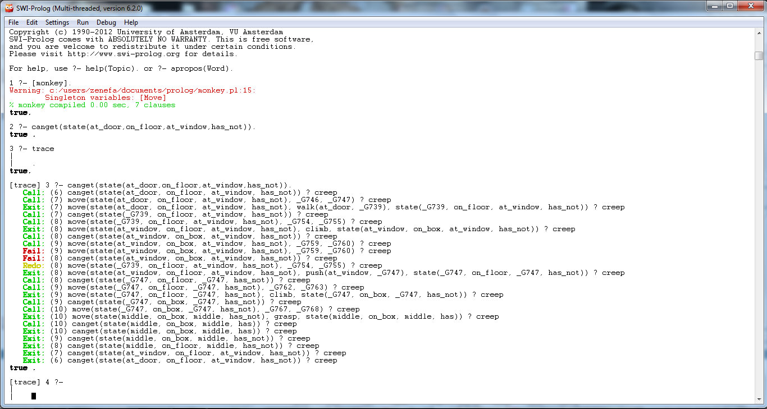

Slide 14
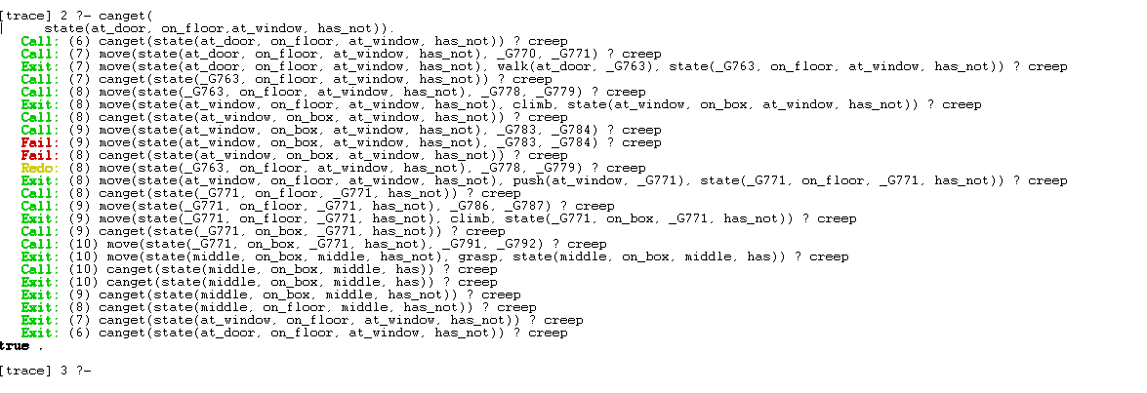

Slide 15
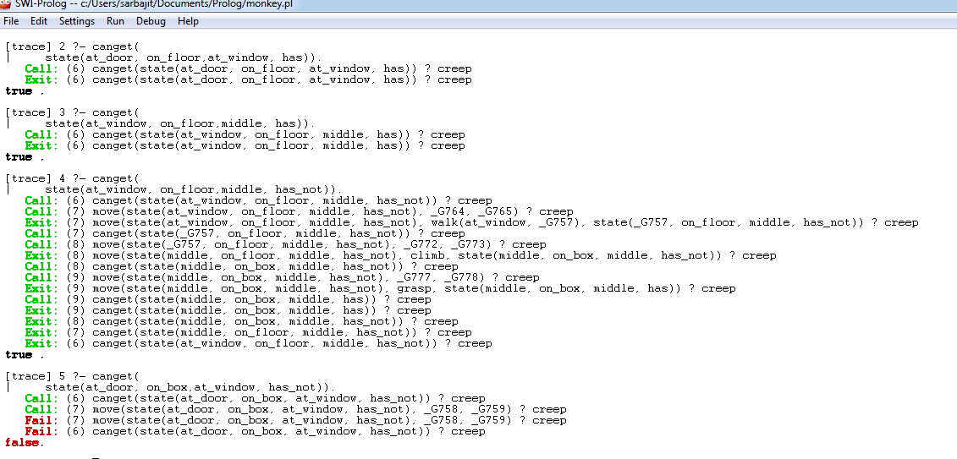

Slide 16
Order of Clauses and Goals
Danger of indefinite looping : occurs when we change the order of Action.
Program variation through reordering of clauses and goals

Slide 17
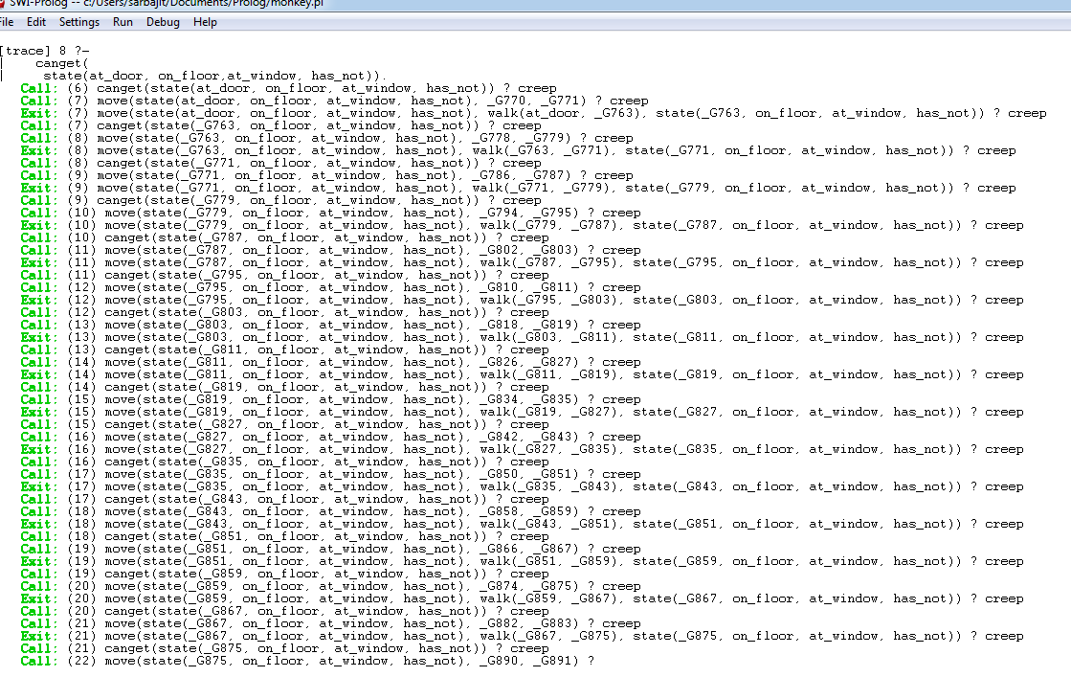

Slide 18

THANK
YOU !!!

